Slide 1
INTRODUCTION TO PYTHON: DATA TYPES, VARIABLES, INPUT, OUTPUT AND CONDITIONAL STATEMENTS
Farhan Sadaf
Lecturer,
CSE, KUET

Slide 2
PYTHON OVERVIEW
Python is a high-level, interpreted, interactive, and object oriented-scripting language.
Python was designed to be highly readable which uses English keywords frequently where as other languages use punctuation.
It has fewer syntactical constructions than other languages.

Slide 3
PYTHON OVERVIEW (CONT’D)
Python is Interpreted: This means that it is processed at runtime by the interpreter and you do not need to compile your program before executing it. This is similar to PERL and PHP.
Python is Interactive: This means that you can actually sit at a Python prompt and interact with the interpreter directly to write your programs.

Slide 4
PYTHON OVERVIEW (CONT’D)
Python is Object-Oriented: This means that Python supports Object-Oriented style or technique of programming that encapsulates code within objects.
Python is Beginner's Language: Python is a great language for the beginner programmers and supports the development of a wide range of applications, from simple text processing to WWW browsers to games.

Slide 5
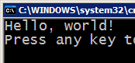



COMPILING AND INTERPRETING
Many languages require you to compile (translate) your program into a form that the machine understands.
Python is instead directly interpreted into machine instructions.
compile
execute
source code
Hello.java
byte code
Hello.class
output
interpret
source code
Hello.py
output

Slide 6
HISTORY OF PYTHON
Python was developed by Guido van Rossum in the late eighties and early nineties at the National Research Institute for Mathematics and Computer Science in the Netherlands.
Python is derived from many other languages, including ABC, Modula-3, C, C++, Algol-68, SmallTalk, and Unix shell and other scripting languages.
Python is copyrighted, Like Perl, Python source code is now available under the GNU General Public License (GPL).
Python is now maintained by a core development team at the institute, although Guido van Rossum still holds a vital role in directing it's progress.

Slide 7
PYTHON FEATURES
Easy-to-learn: Python has relatively few keywords, simple structure, and a clearly defined syntax.
Easy-to-read: Python code is much more clearly defined and visible to the eyes.
Easy-to-maintain: Python's success is that its source code is fairly easy-to-maintain.

Slide 8
PYTHON FEATURES (CONT’D)
A broad standard library: One of Python's greatest strengths is the bulk of the library is very portable and cross-platform compatible on UNIX, Windows, and Macintosh.
Interactive Mode: Support for an interactive mode in which you can enter results from a terminal right to the language, allowing interactive testing and debugging of snippets of code.

Slide 9
PYTHON FEATURES (CONT’D)
Portable: Python can run on a wide variety of hardware platforms and has the same interface on all platforms.
Extendable: You can add low-level modules to the Python interpreter. These modules enable programmers to add to or customize their tools to be more efficient.
Databases: Python provides interfaces to all major commercial databases.

Slide 10
PYTHON FEATURES (CONT’D)
GUI Programming: Python supports GUI applications that can be created and ported to many system calls, libraries, and windows systems, such as Windows MFC, Macintosh, and the X Window system of Unix.
Scalable: Python provides a better structure and support for large programs than shell scripting.

Slide 11
PYTHON - BASIC SYNTAX
Interactive Mode Programming:
>>> print("Hello, Python!”)
Hello, Python!
>>> 3+4*5;
23

Slide 12
PYTHON - BASIC SYNTAX (CONT’D)
Script Mode Programming :
Invoking the interpreter with a script parameter begins execution of the script and continues until the script is finished. When the script is finished, the interpreter is no longer active.
For example, put the following in one test.py, and run,
print("Hello, Python!”)
print("I love COMP3050!”)
The output will be:
Hello, Python!
I love COMP3050!

Slide 13
PYTHON - BASIC SYNTAX (CONT’D)
Python Indentation:
Indentation refers to the spaces at the beginning of a code line.
Whereas in other programming languages the indentation in code is for readability only, the indentation in Python is very important.
Python uses indentation to indicate a block of code.
if 5 > 2: print("Five is greater than two!")
if 5 > 2: print("Five is greater than two!")
Correct
Incorrect

Slide 14
PYTHON IDENTIFIERS
A Python identifier is a name used to identify a variable, function, class, module, or other object. An identifier starts with a letter A to Z or a to z or an underscore (_) followed by zero or more letters, underscores, and digits (0 to 9).
Python does not allow punctuation characters such as @, $, and % within identifiers. Python is a case sensitive programming language. Thus Manpower and manpower are two different identifiers in Python.

Slide 15
PYTHON IDENTIFIERS (CONT’D)
Here are following identifier naming convention for Python:
Class names start with an uppercase letter and all other identifiers with a lowercase letter.
Starting an identifier with a single leading underscore indicates by convention that the identifier is meant to be private.
Starting an identifier with two leading underscores indicates a strongly private identifier.
If the identifier also ends with two trailing underscores, the identifier is a language-defined special name.

Slide 16
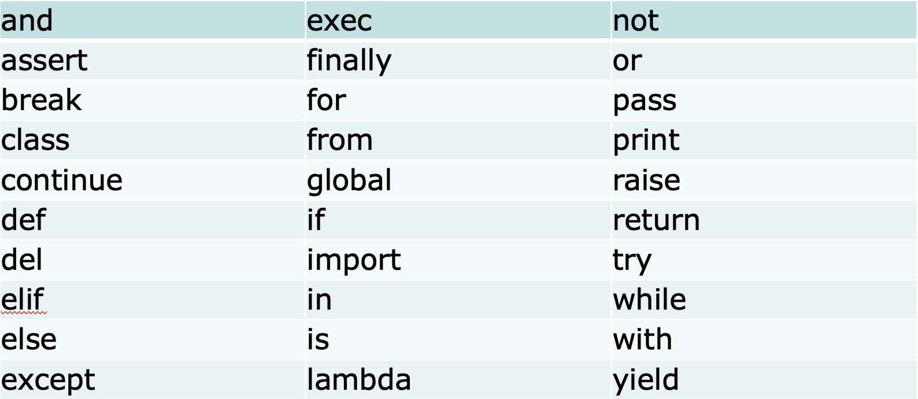
RESERVED WORDS
Keywords contain lowercase letters only.

Slide 17
MULTILINE STATEMENT
Statements in Python typically end with a new line. Python does, however, allow the use of the line continuation character (\) to denote that the line should continue. For example:
total = item_one + \
item_two + \
item_three
Statements contained within the [], {}, or () brackets do not need to use the line continuation character. For example:
days = ['Monday', 'Tuesday', 'Wednesday', 'Thursday', 'Friday']

Slide 18
QUOTATION IN PYTHON
Python accepts single ('), double (") and triple (''' or """) quotes to denote string literals, as long as the same type of quote starts and ends the string.
The triple quotes can be used to span the string across multiple lines. For example, all the following are legal:
word = 'word'
sentence = "This is a sentence."
paragraph = """This is a paragraph. It is made up of multiple lines and sentences."""

Slide 19
COMMENTS IN PYTHON
A hash sign (#) that is not inside a string literal begins a comment.
All characters after the # and up to the physical line end are part of the comment, and the Python interpreter ignores them.

Slide 20
PYTHON - VARIABLE
Variables are nothing but reserved memory locations to store values.
This means that when you create a variable you reserve some space in memory.
Based on the data type of a variable, the interpreter allocates memory and decides what can be stored in the reserved memory.
Therefore, by assigning different data types to variables, you can store integers, decimals, or characters in these variables.

Slide 21
ASSIGNING VALUES TO VARIABLES
Python variables do not have to be explicitly declared to reserve memory space.
The declaration happens automatically when you assign a value to a variable.
The equal sign (=) is used to assign values to variables.
counter = 100 # An integer assignment
miles = 1000.0 # A floating point
name = "John" # A string
print(counter)
print(miles)
print(name)

Slide 22
MULTIPLE ASSIGNMENT
You can also assign a single value to several variables simultaneously. For example:
a = b = c = 1
a, b, c = 1, 2, "john"

Slide 23
STANDARD DATA TYPES
Numbers
String
Boolean
List
Tuple
Dictionary

Slide 24
PYTHON NUMBERS
Number data types store numeric values.
They are immutable data types, which means that changing the value of a number data type results in a newly allocated object.
Number objects are created when you assign a value to them. For example:
var1 = 1
var2 = 10

Slide 25
PYTHON NUMBERS (CONT’D)
Python supports four different numerical types:
int (signed integers)
long (long integers [can also be represented in octal and hexadecimal])
float (floating point real values)
complex (complex numbers)

Slide 26
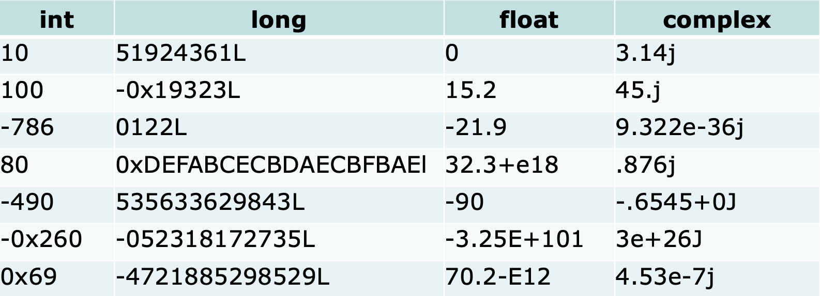
NUMBER EXAMPLES

Slide 27
PYTHON STRING
Strings in Python are identified as a contiguous set of characters in between quotation marks.
Python allows for either pairs of single or double quotes. Subsets of strings can be taken using the slice operator ( [ ] and [ : ] ) with indexes starting at 0 in the beginning of the string and working their way from -1 at the end.
The plus ( + ) sign is the string concatenation operator, and the asterisk ( * ) is the repetition operator.

Slide 28
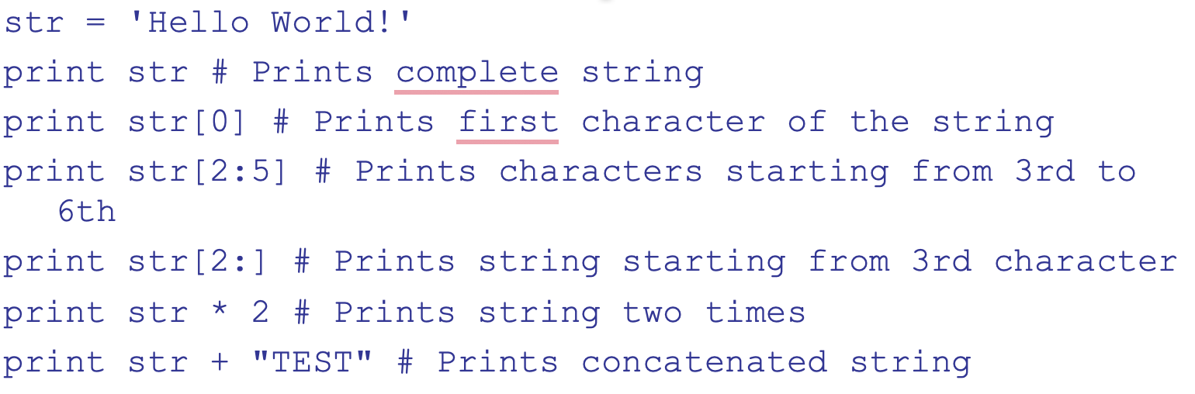
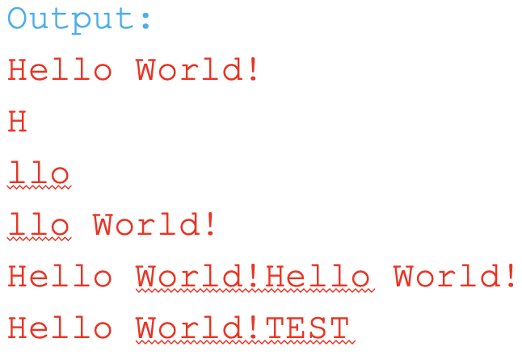
STRING EXAMPLE

Slide 29
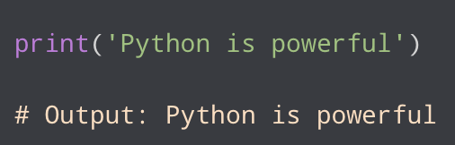
PYTHON OUTPUT
In Python, we can simply use the print() function to print output. For example,
Here, the print() function displays the string enclosed inside the single quotation.

Slide 30
PYTHON OUTPUT (CONT’D)
The print function accepts 5 parameters
print(object= ,separator= ,end= ,file= ,flush= )Here,
object - value(s) to be printed
sep (optional) - allows us to separate multiple objects inside print().
end (optional) - allows us to add add specific values like new line "\n", tab "\t"
file (optional) - where the values are printed. It's default value is sys.stdout (screen)
flush (optional) - boolean specifying if the output is flushed or buffered. Default: False

Slide 31
PYTHON OUTPUT (EXAMPLE)
# print with end whitespace
print('Good Morning!', end= ' ‘)
print('It is rainy today’)
Output: Good Morning! It is rainy today
# print with sep parameter
print('New Year', 2024, 'See you soon!', sep= '. ‘)
Output: New Year. 2024. See you soon!

Slide 32
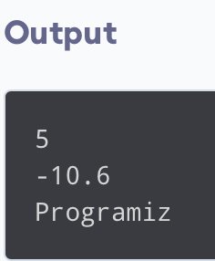
PYTHON OUTPUT (EXAMPLE)
# print python variables and literals
number = -10.6
name = "Programiz"
# print literals
print(5)
# print variables
print(number)
print(name)

Slide 33
OUTPUT FORMATTING
Sometimes we would like to format our output to make it look attractive. This can be done by using the str.format() method. For example,
x = 5
y = 10
print('The value of x is {} and y is {}'.format(x,y))
Here, the curly braces {} are used as placeholders. We can specify the order in which they are printed by using numbers (tuple index).

Slide 34
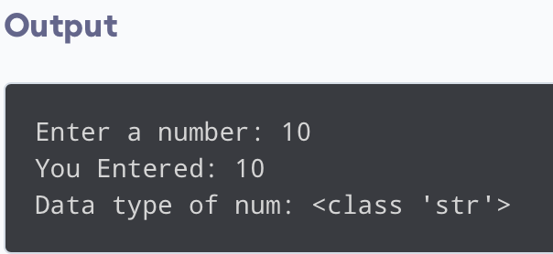
PYTHON INPUT
# using input() to take user input
num = input('Enter a number: ')
print('You Entered:', num)
print('Data type of num:', type(num))
In the above example, we have used the input() function to take input from the user and stored the user input in the num variable.
It is important to note that the entered value 10 is a string, not a number. So, type(num)returns <class 'str’>.
To convert user input into a number we can use int() or float() functions as:
num = int(input('Enter a number: '))

Slide 35
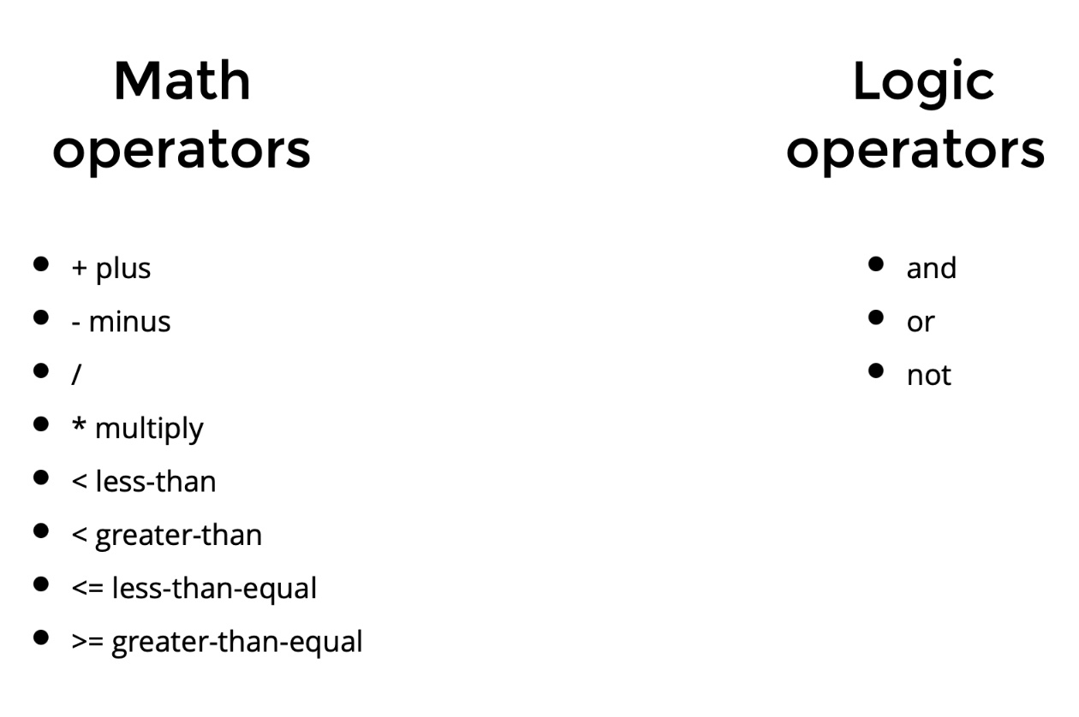
PYTHON - OPERATORS

Slide 36
PYTHON IF...ELSE STATEMENT
Suppose we need to assign different grades to students based on their scores.
If a student scores above 90, assign grade A
If a student scores above 75, assign grade B
If a student scores above 65, assign grade C
These conditional tasks can be achieved using the if statement.

Slide 37
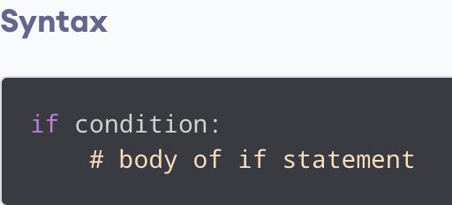
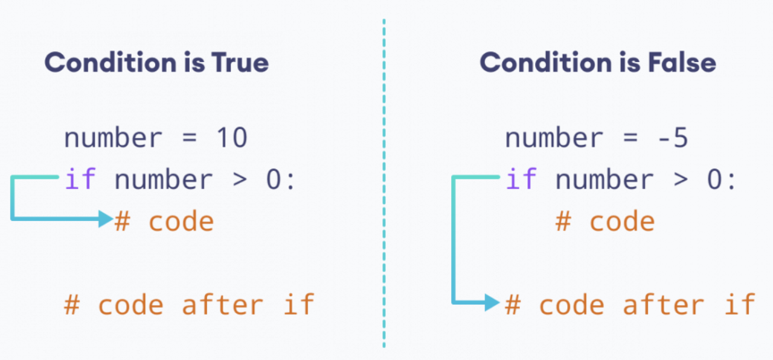
IF STATEMENT
Here, if the condition of the if statement is:
True - the body of the if statement executes.
False - the body of the if statement is skipped from execution.

Slide 38
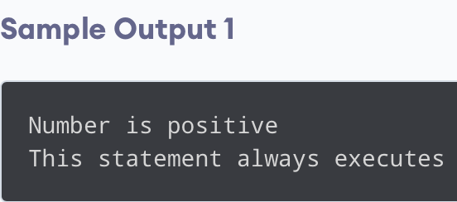
IF STATEMENT (EXAMPLE)
number = 10
# check if number is greater than 0
if number > 0:
print('Number is positive')
print('This statement always executes')

Slide 39
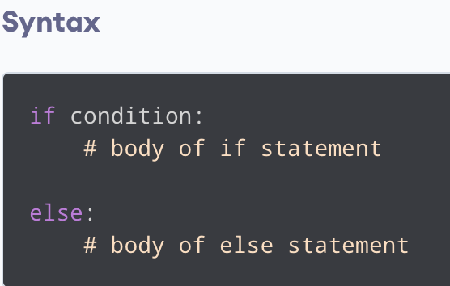
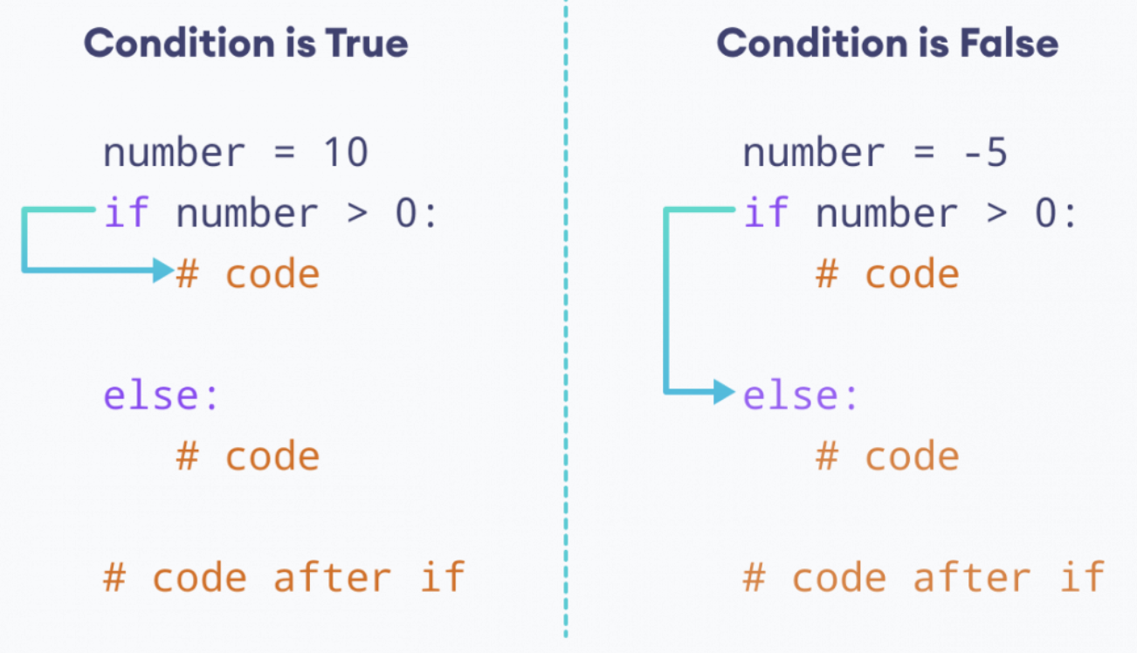
IF...ELSE STATEMENT
Here, if the condition inside the if statement evaluates to
True - the body of if executes, and the body of else is skipped.
False - the body of else executes, and the body of if is skipped

Slide 40
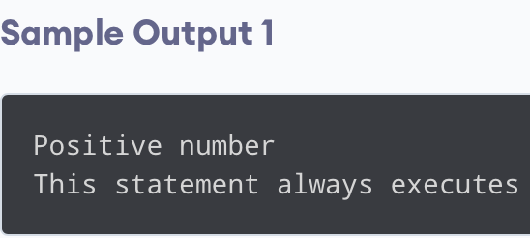
IF...ELSE STATEMENT (EXAMPLE)
number = 10
if number > 0:
print('Positive number')
else:
print('Negative number')
print('This statement always executes')

Slide 41
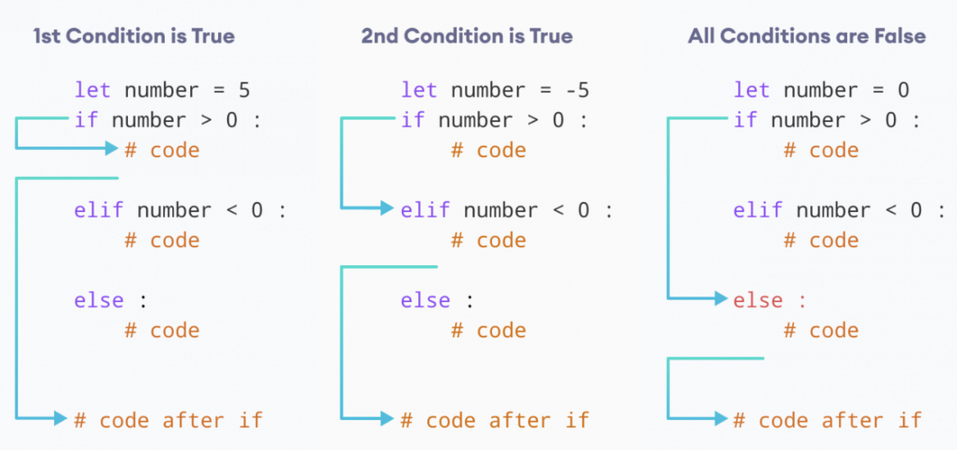
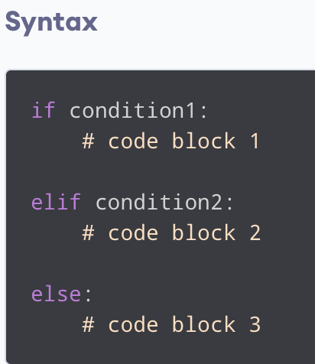
IF...ELIF...ELSE STATEMENT

Slide 42
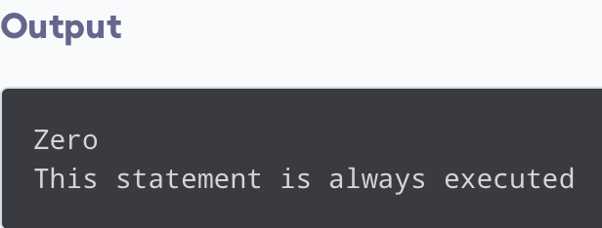
IF...ELIF...ELSE (EXAMPLE)
number = 0
if number > 0:
print('Positive number')
elif number <0:
print('Negative number')
else:
print('Zero')
print('This statement is always executed')

Slide 43
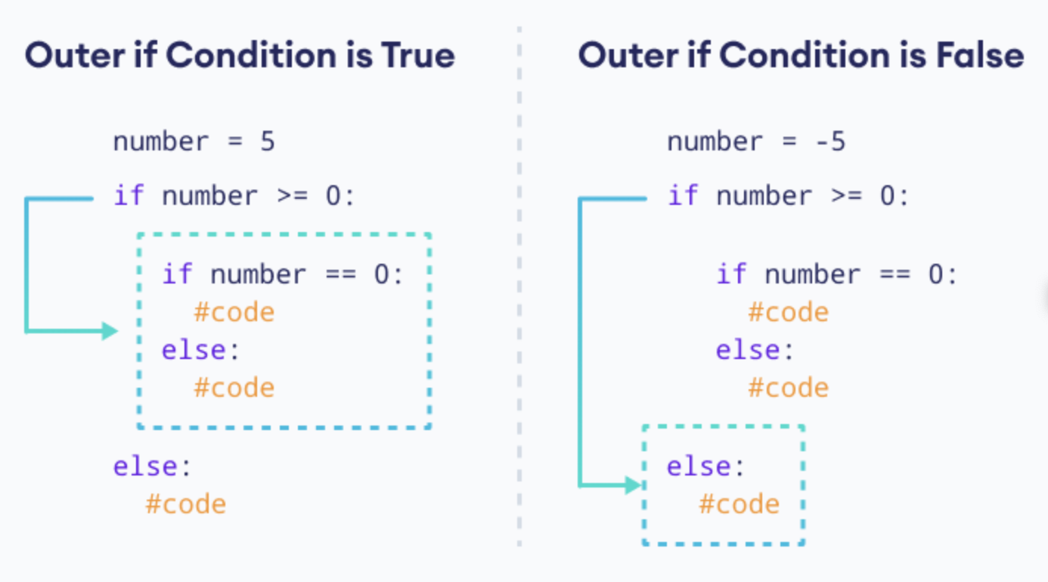
NESTED IF STATEMENTS

Slide 44
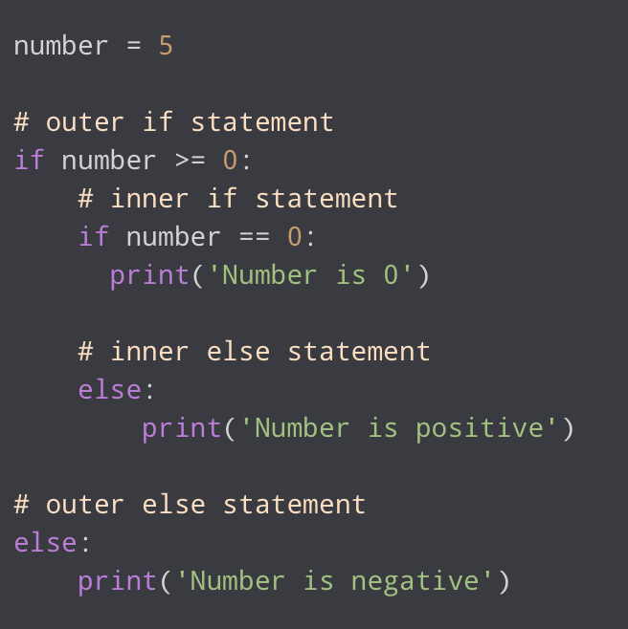
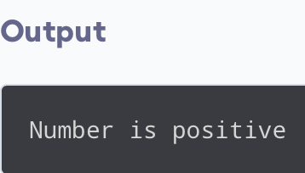
NESTED IF STATEMENTS (EXAMPLE)

Slide 45
REFERENCES
https://www.programiz.com/python-programming/if-elif-else
https://www.geeksforgeeks.org/python-data-types/
https://hub.salford.ac.uk/psytech/python/variables-data-types-python/
https://www.tnstate.edu/faculty/fyao/COMP3050/Py-Slides-1.ppt

